Slide 1
JS HTML DOM Review
Week 3, Day 2

Slide 2
Announcements
Attendance || No Pen – NO EXCEPTIONS (policy)
Futsal Tomorrow!!! (You guys can do it!)
Culture Class tomorrow
Correct Spelling of your name!!!
Test and Project on Friday
Female Futsal – anymore? (On Thursday)

Slide 3
HTML DOM
Document Object Model
Represents HTML elements as JavaScript objects
Allows us to dynamically add, remove, and modify HTML elements and their CSS styles

Slide 4
Review: Element and Content
document.getElementById(“id1”)
Element object
.innerHTML property
Content of the element
<div id=”id1”>Good luck!</div>
var x = document.getElementById(“id1”).innerHTML;
window.alert(x);

Slide 5
Getting Elements
.getElementById(“id1”)
A single element
.getElementsByTagName(“p”)
A list of elements
.getElementsByClassName(“class1”)
A list of elements
<div id=”id1”>
<p>hi</p>
<p>bye</p>
</div>
<p>wow</p>
var a = document.getElementsByTagName(“p”);
var b = document.getElementById(“id1”);
var c = b.getElementsByTagName(“p”);
a[0].innerHTML = ?
c[1].innerHTML = ?
“hi”
“hi”

Slide 6
Changing Contents and Attributes
Changing contents
.innerHTML property of the element
Changing attribute values
.attributename property
<a href=”https://www.google.com/”>
Click here.
</a>
var element = document.getElementById(“id1”);
element.innerHTML = “CLICK!”;
element.href = “index2.html”;
<a href=”index2.html”>
CLICK!
</a>

Slide 7
Changing CSS Styling
Changing a style property
.style.propertyname
<div id=”id1” style=”width:100px; height:100px; background-color:red;”></div>
var element = document.getElementById(“id1”);
element.style.backgroundColor = “blue”;

Slide 8
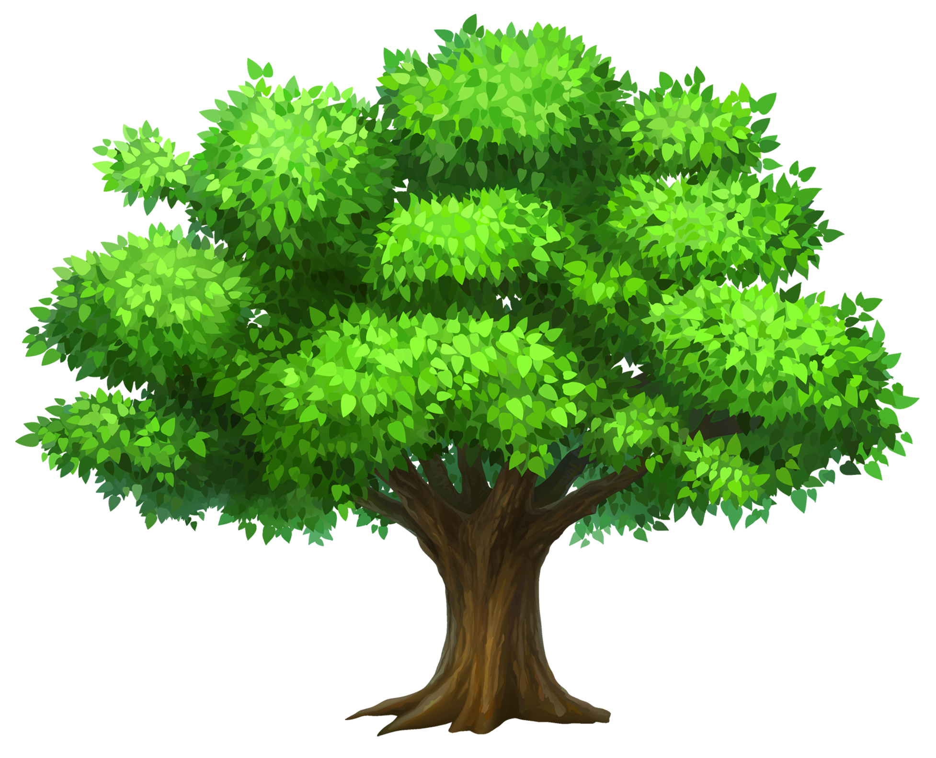
Document Tree Navigation
Terminologies: node, root node, parent, sibling, child
Every element (except for root) has one parent
A sibling is any element that shares a parent

Slide 9
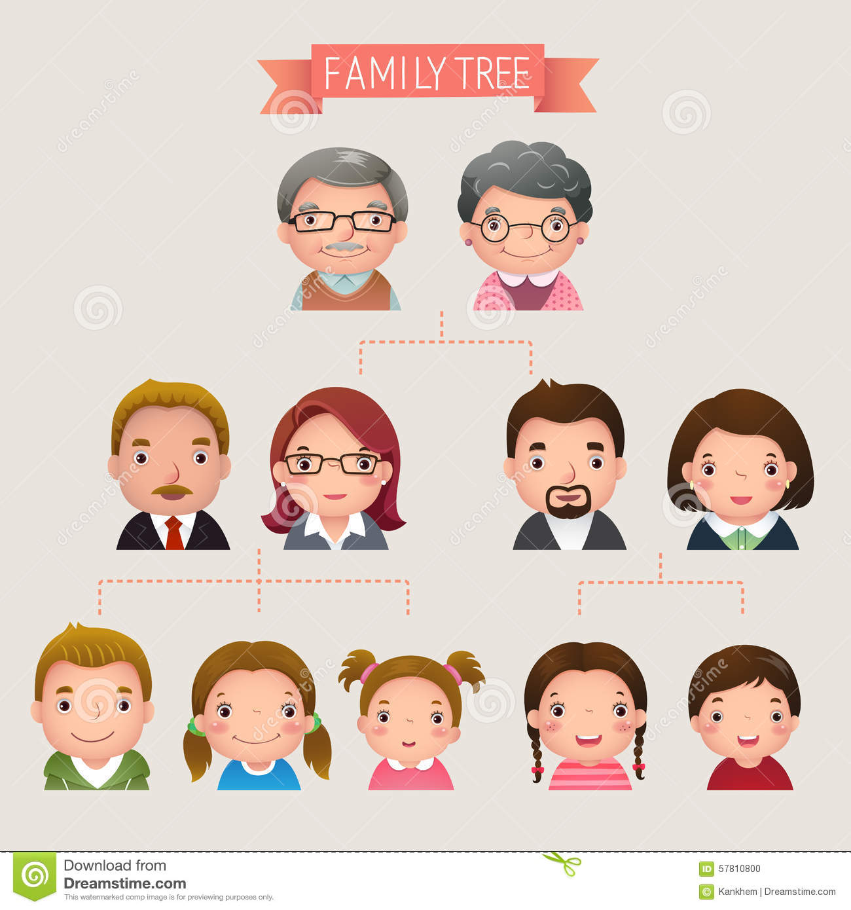
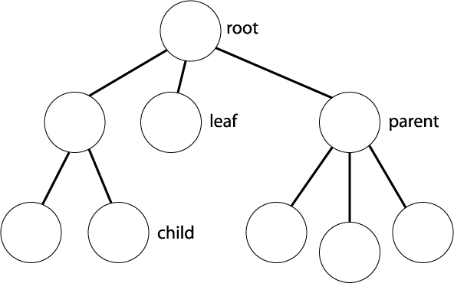
Think of a family tree

Slide 10
Example of HTML DOM Tree Navigation
<!DOCTYPE html>
<html>
<head>
<title>My title</title>
</head>
<body>
<a href = “www.a.com”> My link</a>
<h1>My header</h1>
</body>
</html>

Slide 11
Document Tree Navigation
Properties
.parentNode
.childNodes
List of nodes
.firstChild
.lastChild
.nextSibling
.previousSibling
<html> <head id=”id1”> <title>DOM Tutorial</title> </head> <body> <h1>DOM Lesson one</h1> <p>Hello world!</p> </body> </html>
document.getElementsByTagName(“p”)[0]
document.getElementById(“id1”).nextSibling.lastChild

Slide 12
Element:
<body>
Element:
<p>
Element:
<head>
ID: “id1”
Text:
DOM Tutorial
Element:
<title>
Root element: <html>
Element:
<h1>
Text:
DOM Lesson One
Text:
Hello world!
Document
document.getElementsByTagName(“p”)[0].innerHTML
document.getElementById(“id1”).nextSibling.lastChild
“Hello World”
<p>

Slide 13
Text Node
Text contents inside of elements are also nodes (called text nodes)
The content of a text node can be accessed with .nodeValue
.innerHTML is equivalent to .firstChild.nodeValue
<html> <head id=”id2”> <title>DOM Tutorial</title> </head> <body> <h1>DOM Lesson one</h1> <p>Hello world!</p> </body> </html>
document.getElementById(“id2”).innerHTML
document.getElementById(“id2”).firstChild.nodeValue

Slide 14
Element:
<body>
Element:
<p>
Element:
<head>
ID: “id2”
Text:
DOM Tutorial
Element:
<title>
Root element: <html>
Element:
<h1>
Text:
DOM Lesson One
Text:
Hello world!
Document
document.getElementById(“id2”).innerHTML
document.getElementById(“id2”).nextSibling.lastChild.firstChild.nodeValue
X It will return nothing
Hello World!

Slide 15
Adding and Removing Nodes
document.createElement(“tagname”)
Creates an element node
document.createTextNode(“text”)
Creates a text node
parent.appendChild(newChild)
Appends node as the last child
<div id="div1"> <p id="p1">Paragraph 1</p> <p id="p2">Paragraph 2</p> </div>
var para = document.createElement("p");
var node = document.createTextNode(“Paragraph 3"); para.appendChild(node); var element = document.getElementById("div1"); element.appendChild(para);

Slide 16
Element:
<body>
Element:
<head>
Root element: <html>
Element:
<p>
Element:
<p>
Element:
<div>
Document
Text:
Paragraph 1
Text:
Paragraph 3
Element:
<p>
Text:
Paragraph 2
var para = document.createElement("p");
var node = document.createTextNode(“Paragraph 3"); para.appendChild(node); var element = document.getElementById("div1"); element.appendChild(para);

Slide 17
Adding and Removing Nodes
parent.insertBefore(newChild, existingChild)
Appends node as previous sibling of child
<div id="div1"> <p id="p1">Paragraph 1</p> <p id="p2">Paragraph 2</p> </div>
var para = document.createElement("p");
var node = document.createTextNode(“Paragraph 3"); para.appendChild(node); var element = document.getElementById("div1");
var child = document.getELementById(“p2”); element.insertBefore(para, child);

Slide 18
Element:
<body>
Element:
<head>
Root element: <html>
Element:
<p>
Element:
<p>
Element:
<div>
Document
Text:
Paragraph 1
Text:
Paragraph 2
Element:
<p>
Text:
Paragraph 3
var para = document.createElement("p");
var node = document.createTextNode(“Paragraph 3"); para.appendChild(node); var element = document.getElementById("div1");
var child = document.getELementById(“p2”); element.insertBefore(para, child);

Slide 19
Adding and Removing Nodes
parent.removeChild(child)
Removes the child from HTML
<div id="div1"> <p id="p1">Paragraph 1</p> <p id="p2">Paragraph 2</p> </div>
var element = document.getElementById("div1");
var child = document.getELementById(“p1”); element.removeChild(child);

Slide 20
Element:
<body>
Element:
<head>
Root element: <html>
Element:
<p>
Element:
<div>
Document
Text:
Paragraph 2
Element:
<p>
Text:
Paragraph 3
var element = document.getElementById("div1");
var child = document.getELementById(“p1”); element.removeChild(child);

Slide 21
Group Project
Week 3, Day 2

Slide 22
What do we learn today?
Five examples of UI features
Implementation

Slide 23
Interesting UI Features
(1/2)

Slide 24
Interesting Features – Steering
Mac vs. Windows Top Menu Bar (Efficiency)

Slide 25
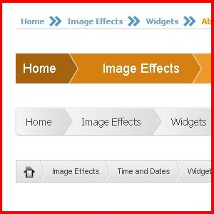
Interesting Features – Double Duty
Breadcrumb & Pagination (Learnability & Efficiency)

Slide 26
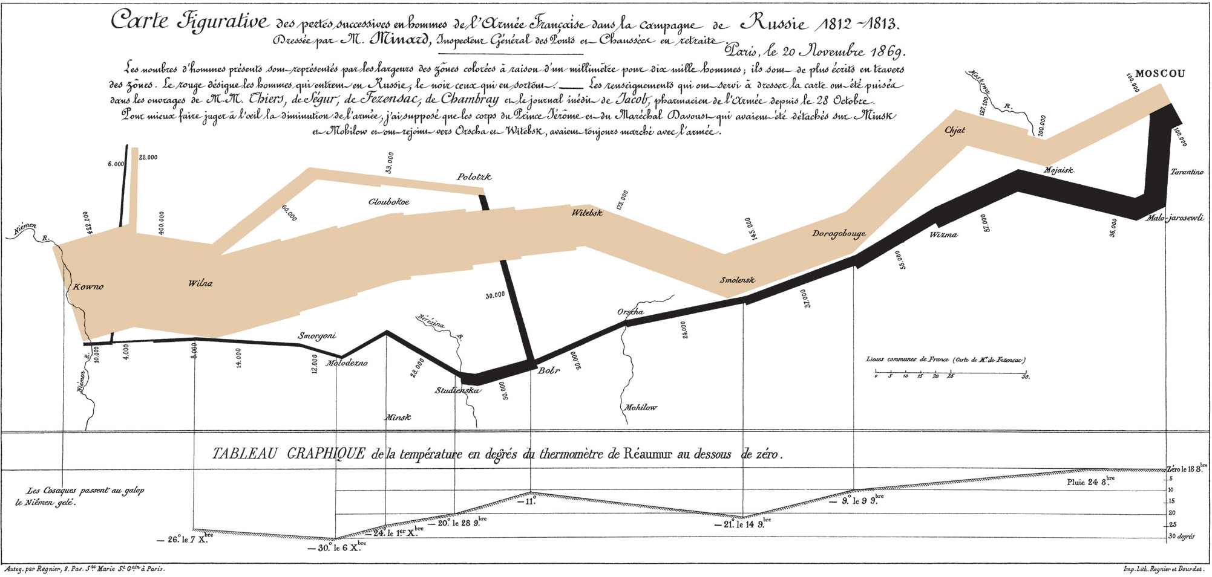
Interesting Features – Information
Graph of Napoleon’s Invasion (Efficiency)

Slide 27
Interesting Features – Language Barrier
Internationalization (Learnability & Efficiency)

Slide 28
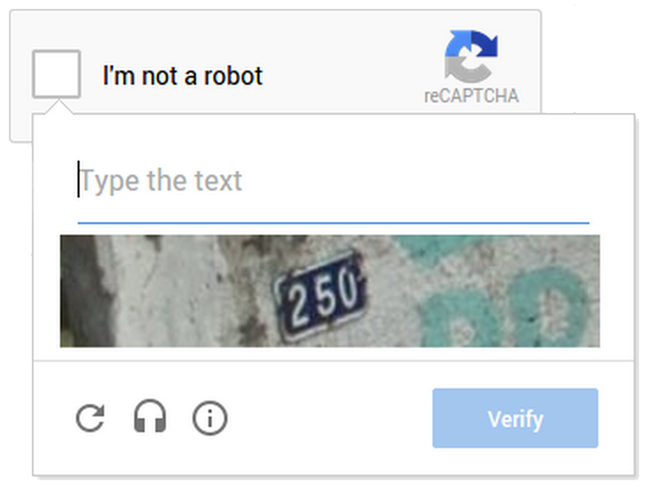
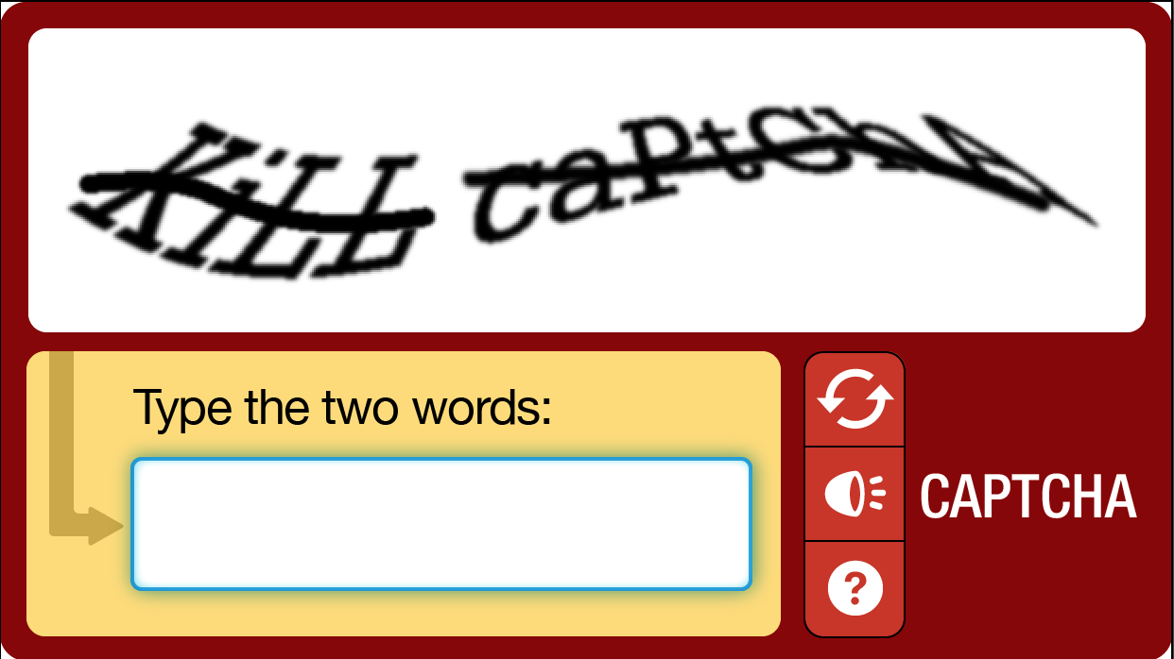
Interesting Features - Crowdsourcing
Captcha (Safety)

Slide 29
Implementation
(2/2)

Slide 30
Tools
Sublime Text
Google Chrome (ver 58.0)
Help Desk from the course website

Slide 31
Tips for implementation
Keep your persona and core tasks in mind
Feel free to go back to the ideation stage
Ask questions to instructors

Slide 32
Wrap-up
Come up with an interesting usable feature
Start implementing your website

